Slide 1
Java 4 WEB
Lesson 15 – Spring Framework

Slide 2
Lesson goals
Inversion of Control
Dependency Injection
Spring Core
XML config vs Annotation config vs Java Config

Slide 3
Inversion of Control
In software engineering, inversion of control (IoC) is a design principle in which custom-written portions of a computer program receive the flow of control from a generic framework. A software architecture with this design inverts control as compared to traditional procedural programming: in traditional programming, the custom code that expresses the purpose of the program calls into reusable libraries to take care of generic tasks, but with inversion of control, it is the framework that calls into the custom, or task-specific, code.

Slide 4
Inversion of Control
Principle helping to write loose coupled code
In object-oriented programming, there are several basic techniques to implement inversion of control. These are:
Using a service locator pattern
Using dependency injection, for example
Constructor injection
Parameter injection
Setter injection
Interface injection
Using template method design pattern
Using strategy design pattern

Slide 5
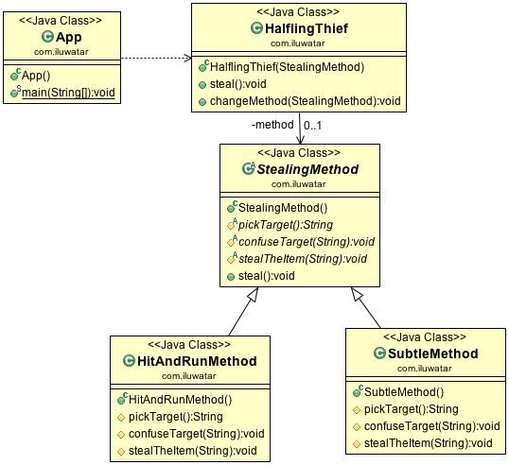
Inversion of Control. Template Method
Define the skeleton of an algorithm in an operation, deferring some steps to subclasses. Template method lets subclasses redefine certain steps of an algorithm without changing the algorithm's structure.

Slide 6
Inversion of Control. Template Method
Code example

Slide 7
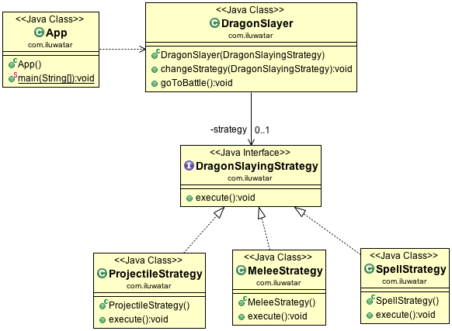
Inversion of Control. Strategy
Define a family of algorithms, encapsulate each one, and make them interchangeable. Strategy lets the algorithm vary independently from clients that use it.

Slide 8
Inversion of Control. Strategy
Code example

Slide 9
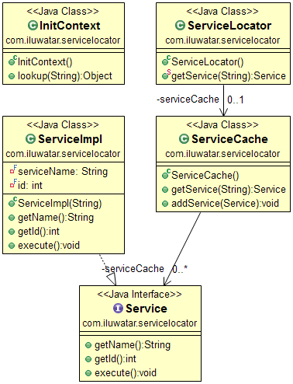
Inversion of Control. Service Locator
The service locator pattern is a design pattern used in software development to encapsulate the processes involved in obtaining a service with a strong abstraction layer. This pattern uses a central registry known as the "service locator", which on request returns the information necessary to perform a certain task. Note that many consider service locator to actually be an anti-pattern.

Slide 10
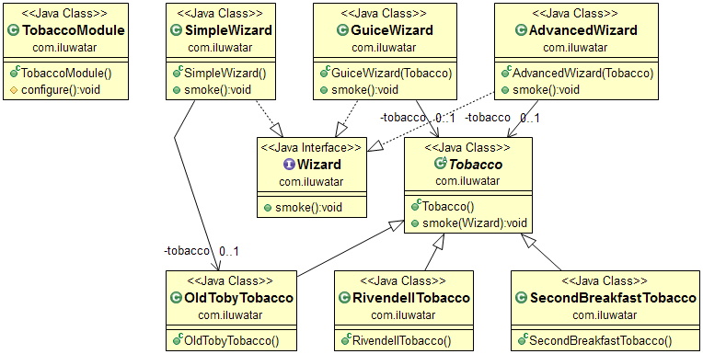
Inversion of Control. Dependency Injection
Dependency Injection is a software design pattern in which one or more dependencies (or services) are injected, or passed by reference, into a dependent object (or client) and are made part of the client's state. The pattern separates the creation of a client's dependencies from its own behavior, which allows program designs to be loosely coupled and to follow the inversion of control and single responsibility principles.

Slide 11
Inversion of Control. Service Locator with Dependency Injection
Code example

Slide 12
Spring Core
The Spring Framework is an application framework and inversion of control container for the Java platform. The framework's core features can be used by any Java application, but there are extensions for building web applications on top of the Java EE (Enterprise Edition) platform. Although the framework does not impose any specific programming model, it has become popular in the Java community as an addition to, or even replacement for the Enterprise JavaBeans (EJB) model. The Spring Framework is open source.

Slide 13
Spring Core. Architecture
Spring Framework
Data Access Integration
Web (MVC/Remoting)
JDBC
ORM
Web
Servlet
OXM
JMS
Portlet
Struts
AOP
Aspects
Instrumentation
Core Container
Beans
Core
Context
Expression Language
Test

Slide 14
Spring Core. ApplicationContext
ApplicationContext
Container of all beans and their dependencies.
The ApplicationContext is the central interface within a Spring application for providing configuration information to the application. It is read-only at run time, but can be reloaded if necessary and supported by the application. A number of classes implement the ApplicationContext interface, allowing for a variety of configuration options and types of applications.
Table
Manager
Bean Factory
Cache
Manager
JDBC
Session
Mamanger
Download
Service
Library
Processor
Connection
Pool
Result
Holder
User
Factory
User
Manager
Form
Manager
FullText Search

Slide 15
Spring Core. ApplicationContext
ApplicationContext
The ApplicationContext provides:
Bean factory methods for accessing application components.
The ability to load file resources in a generic fashion.
The ability to publish events to registered listeners.
The ability to resolve messages to support internationalization.
Inheritance from a parent context.
Table
Manager
Bean Factory
Cache
Manager
JDBC
Session
Mamanger
Download
Service
Library
Processor
Connection
Pool
Result
Holder
User
Factory
User
Manager
Form
Manager
FullText Search

Slide 16
Spring Core. Bean Scopes
Scope | Description
singleton | Scopes a single bean definition to a single object instance per Spring IoC container.
prototype | Scopes a single bean definition to any number of object instances. New object will be created every time on getting from ApplicationContext.
request | Scopes a single bean definition to the lifecycle of a single HTTP request; that is each and every HTTP request will have its own instance of a bean created off the back of a single bean definition. Only valid in the context of a web-aware Spring ApplicationContext.
session | Scopes a single bean definition to the lifecycle of a HTTP Session. Only valid in the context of a web-aware Spring ApplicationContext.
global session | Scopes a single bean definition to the lifecycle of a global HTTP Session. Typically only valid when used in a portlet context. Only valid in the context of a web-aware Spring ApplicationContext.

Slide 17
Spring Core. Bean Definition
property | Description
class | This attribute is mandatory and specifies the bean class to be used to create the bean.
name | This attribute specifies the bean identifier uniquely. In XML-based configuration metadata, you use the id and/or name attributes to specify the bean identifier(s).
scope | This attribute specifies the scope of the objects created from a particular bean definition and it will be discussed in bean scopes chapter.
initialization method | A callback to be called just after all necessary properties on the bean have been set by the container. It will be discussed in bean life cycle chapter.
destruction method | A callback to be used when the container containing the bean is destroyed. It will be discussed in bean life cycle chapter.

Slide 18
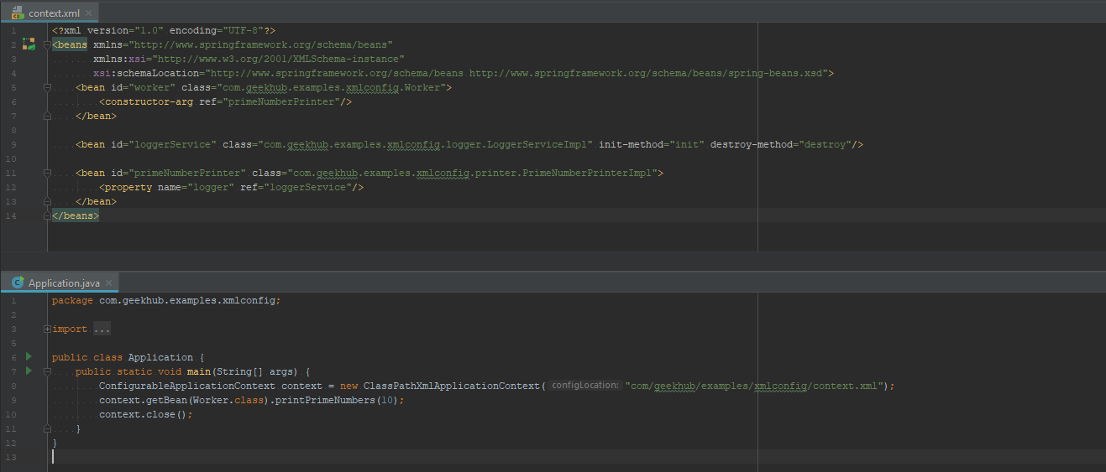
Spring Xml Config

Slide 19
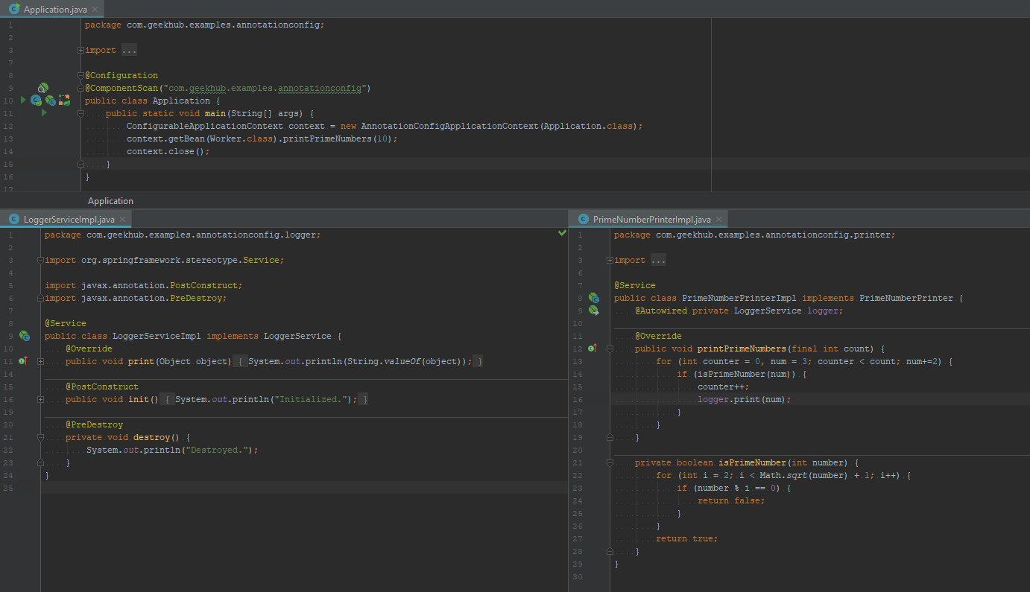
Spring Annotation Config

Slide 20
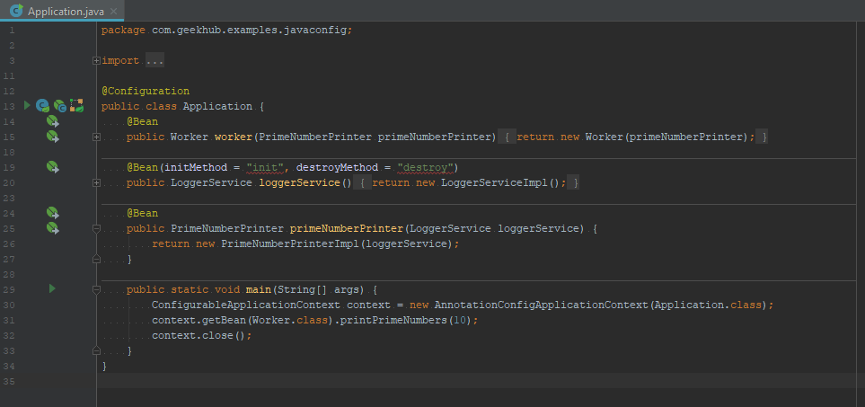
Spring Java Config

Slide 21
Spring IoC Annotations
@Component
@Scope("session")
public class JDBC {
//Spring bean component, does not require to be declared in app context
}
public class UserManager {
//be sure jdbc will be initialized before you start using it
@Autowired private JDBC jdbc;
}
<beans>
<context:annotation-config/>
<context:component-scan base-package=“com.beans"/>
</beans>

Slide 22
Spring Life Cycle Annotations
public class UserManager {
@PostConstruct
public void init() {
//do some initialization work
}
@PreDestroy
public void destroy() {
//release all resources
}
}

Slide 23
Literature
Java Design Patterns - Service Locator
Java Design Patterns - Dependency Injection
Java Design Patterns - Template Method
Java Design Patterns - Strategy
Spring Tutorial
Spring Framework Docs
Inversion of Control and Dependency Injection in Spring

Slide 24
Homework 1
Implement user management API protected with authentication by login and password.
Requirements

